Slide 1
COURSE TITLE: Operating Systems
UNIT - 3

Slide 2
UNIT 3: Deadlock

Slide 3
Deadlock
A deadlock is a situation where a set of processes are blocked because each process is holding a resource and waiting for another resource acquired by some other process.
A Deadlock is a situation where each of the computer process waits for a resource which is being assigned to some another process.
In this situation, none of the process gets executed since the resource it needs, is held by some other process which is also waiting for some other resource to be released.

Slide 4
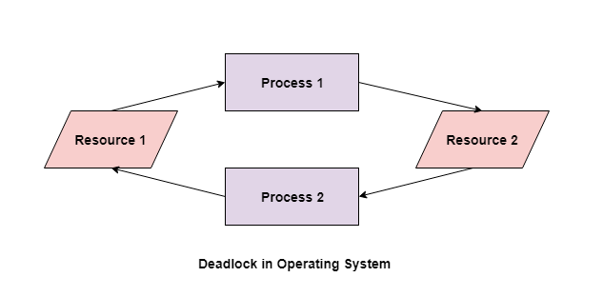
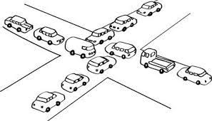
Deadlock

Slide 5
Deadlock
Necessary conditions for Deadlocks
Deadlock can arise if the following four conditions hold simultaneously
1. Mutual Exclusion
A resource can only be shared in mutually exclusive manner. It implies, if two process cannot use the same resource at the same time.
2. Hold and Wait
A process waits for some resources while holding another resource at the same time.

Slide 6
Deadlock
Necessary conditions for Deadlocks
3. No preemption
The process which once scheduled will be executed till the completion. No other process can be scheduled by the scheduler meanwhile.
4. Circular Wait
All the processes must be waiting for the resources in a cyclic manner so that the last process is waiting for the resource which is being held by the first process.

Slide 7
Deadlock detection and recovery.
Deadlock Prevention:
The idea is to not let the system into a deadlock state. This system will make sure that above mentioned four conditions will not arise. These techniques are very costly so we use this in cases where our priority is making a system deadlock-free.
One can zoom into each category individually, Prevention is done by negating one of the above-mentioned necessary conditions for deadlock. Prevention can be done in four different ways:
1. Eliminate mutual exclusion 3. Allow preemption
2. Solve hold and Wait 4. Circular wait Solution

Slide 8
Deadlock detection and recovery.
There are two main approaches to deadlock detection and recovery:
1. Prevention: The operating system takes steps to prevent deadlocks from occurring by ensuring that the system is always in a safe state, where deadlocks cannot occur. This is achieved through resource allocation algorithms such as the Banker’s Algorithm.
2. Detection and Recovery: If deadlocks do occur, the operating system must detect and resolve them. Deadlock detection algorithms, such as the Wait-For Graph, are used to identify deadlocks, and recovery algorithms, such as the Rollback and Abort algorithm, are used to resolve them. The recovery algorithm releases the resources held by one or more processes, allowing the system to continue to make progress.

Slide 9
Deadlock detection and recovery.
Deadlock Detection and Recovery
In this approach, The OS doesn't apply any mechanism to avoid or prevent the deadlocks. Therefore the system considers that the deadlock will definitely occur. In order to get rid of deadlocks.
The OS periodically checks the system for any deadlock. In case, it finds any of the deadlock then the OS will recover the system using some recovery techniques.
The main task of the OS is detecting the deadlocks. The OS can detect the deadlocks with the help of Resource allocation graph.

Slide 10
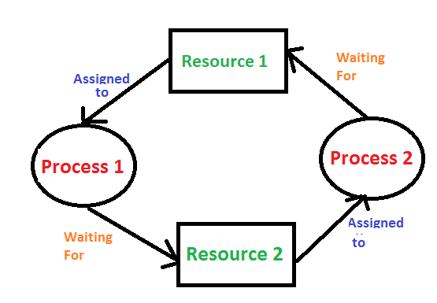
Deadlock detection and recovery.
Deadlock Detection :
1. If resources have a single instance –
In this case for Deadlock detection, we can run an algorithm to check for the cycle in the Resource Allocation Graph. The presence of a cycle in the graph is a sufficient condition for deadlock.

Slide 11
Deadlock detection and recovery.
Deadlock Detection : 1. If resources have a single instance –
In the above diagram, resource 1 and resource 2 have single instances. There is a cycle R1 → P1 → R2 → P2. So, Deadlock is Confirmed.

Slide 12
Deadlock detection and recovery.
2. If there are multiple instances of resources –
Detection of the cycle is necessary but not a sufficient condition for deadlock detection, in this case, the system may or may not be in deadlock varies according to different situations.
3. Wait-For Graph Algorithm –
The Wait-For Graph Algorithm is a deadlock detection algorithm used to detect deadlocks in a system where resources can have multiple instances. The algorithm works by constructing a Wait-For Graph, which is a directed graph that represents the dependencies between processes and resources.

Slide 13
Deadlock detection and recovery.
Deadlock Recovery :
A traditional operating system such as Windows doesn’t deal with deadlock recovery as it is a time and space-consuming process. Real-time operating systems use Deadlock recovery.
1. Killing the process –
Killing all the processes involved in the deadlock. Killing process one by one. After killing each process check for deadlock again and keep repeating the process till the system recovers from deadlock. Killing all the processes one by one helps a system to break circular wait conditions.

Slide 14
Deadlock detection and recovery.
Deadlock Recovery :
2. Resource Preemption –
Resources are preempted from the processes involved in the deadlock, and preempted resources are allocated to other processes so that there is a possibility of recovering the system from the deadlock. In this case, the system goes into starvation.

Slide 15
Deadlock detection and recovery.
Deadlock Recovery :
3. Concurrency Control –
Concurrency control mechanisms are used to prevent data inconsistencies in systems with multiple concurrent processes. These mechanisms ensure that concurrent processes do not access the same data at the same time, which can lead to inconsistencies and errors.

Slide 16
Deadlock Prevention
Deadlock Characteristics
The deadlock has the following characteristics:
Mutual Exclusion
Hold and Wait
No preemption
Circular wait

Slide 17
Deadlock Prevention
Deadlock Prevention
We can prevent a Deadlock by eliminating any of the above four conditions.
1. Eliminate Mutual Exclusion:
It is not possible to dis-satisfy the mutual exclusion because some resources, such as the tape drive and printer, are inherently non-shareable.

Slide 18
Deadlock Prevention
Deadlock Prevention
2. Eliminate Hold and wait:
Allocate all required resources to the process before the start of its execution, this way hold and wait condition is eliminated
3. Eliminate No Preemption
Preempt resources from the process when resources are required by other high-priority processes.

Slide 19
Deadlock Prevention
4. Eliminate Circular Wait
Each resource will be assigned a numerical number. A process can request the resources to increase/decrease. order of numbering. For Example, if the P1 process is allocated R5 resources, now next time if P1 asks for R4, R3 lesser than R5 such a request will not be granted, only a request for resources more than R5 will be granted.

Slide 20
Deadlock avoidance
Deadlock avoidance is another technique used in operating systems to deal with deadlocks.
Unlike deadlock prevention, which aims to eliminate the possibility of deadlocks, deadlock avoidance focuses on dynamically detecting and avoiding situations that could lead to deadlocks.
In deadlock avoidance, the request for any resource will be granted if the resulting state of the system doesn't cause deadlock in the system. The state of the system will continuously be checked for safe and unsafe states.

Slide 21
Deadlock avoidance
In order to avoid deadlocks, the process must tell OS, the maximum number of resources a process can request to complete its execution.
A state of the system is called safe if the system can allocate all the resources requested by all the processes without entering into deadlock.
If the system cannot fulfill the request of all processes then the state of the system is called unsafe.
The key of Deadlock avoidance approach is when the request is made for resources then the request must only be approved in the case if the resulting state is also a safe state.

Slide 22
Deadlock avoidance
The System is said to be in a Safe state if all the resources required by the Process are satisfied with the resources that are currently available.
The System is said to be in an unsafe state if all of the resource requirements of the Process cannot be met by the available resources in any way.

Slide 23
Deadlock avoidance
Avoiding Deadlock: Resource Trajectories
Two non-sharable resources and two processes.
Horizontal Axis: Number of instructions executed by process P1.
Vertical Axis: Number of instructions executed by process P2.
Shaded regions represent impossible situations: both P1 and P2 having a nonsharable resource.

Slide 24
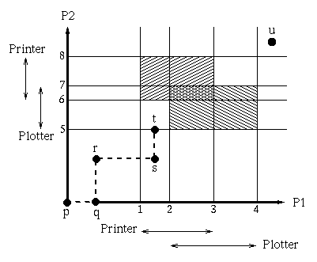
Deadlock avoidance
Avoiding Deadlock: Resource Trajectories
P1 scheduled: goes from p to q,
P2 scheduled: goes from q to r,
P1 scheduled: goes from r to s,
P2 scheduled: goes from s to t.

Slide 25
Two Phase Locking
A transaction is said to follow the Two-Phase Locking protocol if Locking and Unlocking can be done in two phases.
Growing Phase: New locks on data items may be acquired but none can be released.
Shrinking Phase: Existing locks may be released but no new locks can be acquired.
Note: If lock conversion is allowed, then upgrading of lock( from S(a) to X(a) ) is allowed in the Growing Phase, and downgrading of lock (from X(a) to S(a)) must be done in the shrinking phase.

Slide 26
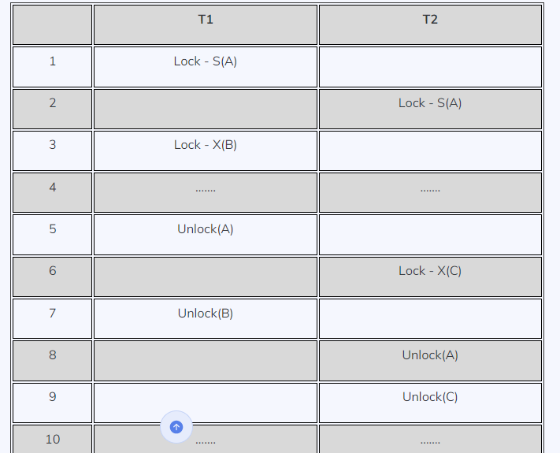
Two Phase Locking

Slide 27
Two Phase Locking
Transaction T1
The growing Phase is from steps 1-3
The shrinking Phase is from steps 5-7
Lock Point at 3
Transaction T2
The growing Phase is from steps 2-6
The shrinking Phase is from steps 8-9
Lock Point at 6

Slide 28
Two Phase Locking
Deadlock in 2-PL
Consider this simple example, it will be easy to understand. Say we have two transactions T1 and T2.
Schedule:
Drawing the precedence graph, you may detect the loop. So Deadlock is also possible in 2-PL.
T1 | T2
Lock-X1(A) | Lock-X1(B)
Lock-X2(B) | Lock-X2(A)

Slide 29
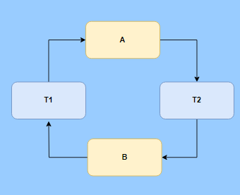
Two Phase Locking
Deadlock in 2-PL
Consider this simple example, it will be easy to understand. Say we have two transactions T1 and T2.
Phase 1 - Lock Request:
Process T1 acquires a lock on Resource A.
Process T2 acquires a lock on Resource B.
Phase 2 - Lock Release:
Process T1 now needs Resource B to proceed further, but it cannot release Resource A until it has both resources due to the two-phase locking rule.
Process T2 similarly needs Resource A to continue, but it's holding onto Resource B.

Slide 30
Security mechanism and policy.
What is Operating System Security?
The process of ensuring OS availability, confidentiality, integrity is known as operating system security.
OS security refers to the processes or measures taken to protect the operating system from dangers, including viruses, worms, malware, and remote hacker intrusions.
Operating system security comprises all preventive-control procedures that protect any system assets that could be stolen, modified, or deleted if OS security is breached.

Slide 31
Security mechanism and policy.
System security may be threatened through two violations, and these are as follows:
1. Threat
A program that has the potential to harm the system seriously.
2. Attack
A breach of security that allows unauthorized access to a resource.

Slide 32
Security mechanism and policy.
Security may be compromised through the breaches. Some of the breaches are as follows:
1. Breach of integrity
This violation has unauthorized data modification.
2. Theft of service
It involves the unauthorized use of resources.
3. Breach of confidentiality
It involves the unauthorized reading of data.

Slide 33
Security mechanism and policy.
Operating System Security Policies and Procedures
As OS security policies and procedures cover a large area, there are various techniques to addressing them. Some of them are as follows:
Installing and updating anti-virus software
Ensure the systems are patched or updated regularly
Implementing user management policies to protect user accounts and privileges.
Installing a firewall and ensuring that it is properly set to monitor all incoming and outgoing traffic.

Slide 34
Domain of protection
"Domain of Protection" refers to the level of protection provided to different resources and operations within a system to prevent or mitigate deadlocks. It encompasses various mechanisms and strategies to manage and control access to resources in a way that reduces the risk of deadlocks. Here are some key components of the domain of protection in deadlock management:
Resource Allocation Policies:
The domain of protection includes policies and rules for allocating resources, such as memory, CPU time, or I/O devices, in a manner that minimizes the likelihood of deadlocks. For example, resource allocation can follow strategies like "resource allocation graph" or "banker's algorithm" to ensure that resources are allocated in a safe and non-blocking manner.

Slide 35
Domain of protection
2. Process Synchronization:
Protection mechanisms are implemented to allow processes to synchronize their access to shared resources. This involves using synchronization primitives like semaphores, mutexes, and condition variables to ensure that processes request and release resources in an orderly fashion.
3. Resource Locking: Resources can be protected by locking mechanisms to ensure exclusive access when required. Locks can be used to prevent multiple processes from concurrently accessing critical sections of code or shared resources, reducing the risk of contention and potential deadlocks.

Slide 36
Domain of protection
4. Deadlock Detection: The domain of protection also includes mechanisms for detecting deadlocks when they occur. This may involve periodically checking the system's resource allocation state, analyzing the resource allocation graph, or using other techniques to identify potential deadlock situations.

Slide 37
Domain of protection
4. Deadlock Detection: The domain of protection also includes mechanisms for detecting deadlocks when they occur. This may involve periodically checking the system's resource allocation state, analyzing the resource allocation graph, or using other techniques to identify potential deadlock situations.
5. Resource Priority: Some systems may prioritize resource allocation based on criteria such as process priority or resource type. Adjusting resource allocation priorities can help reduce the chances of high-priority processes being blocked by low-priority ones in a deadlock situation.

Slide 38
Domain of protection
6. Resource Preemption: In some cases, the domain of protection includes strategies for preempting resources from lower-priority processes to resolve a deadlock. This may involve forcibly taking resources away from a process to break the deadlock, but it should be done carefully to avoid data corruption or undesirable behavior.

Slide 39
Access matrix
Access Matrix is a security model of protection state in computer system. It is represented as a matrix.
Access matrix is used to define the rights of each process executing in the domain with respect to each object.
The rows of matrix represent domains and columns represent objects. Each cell of matrix represents set of access rights which are given to the processes of domain means each entry(i, j) defines the set of operations that a process executing in domain Di can invoke on object Oj.

Slide 40
Access matrix
Different types of rights:
There are different types of rights the files can have. The most common ones are:
Read- This is a right given to a process in a domain, which allows it to read the file.
Write- Process in domain can write into the file.
Execute- Process in domain can execute the file.
Print- Process in domain only has access to printer.

Slide 41
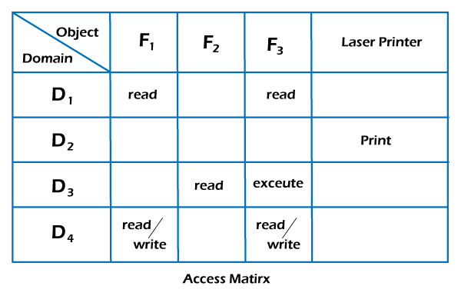
Access matrix
Let us now understand how an access matrix works from the example given below.

Slide 42
Access matrix
In this example, there are 4 domains and objects in the above matrix, and also consider 3 files (including F1, F2, and F3) and one printer.
Files F1 and F3 can be read by a process running in D1. A process running in domain D4 has the same rights as D1, but it may also write on files.
Only one process running in domain D2 has access to the printer. The access matrix mechanism is made up of various policies and semantic features.
Specifically, we should ensure that a process running in domain Di may only access the objects listed in row i

Slide 43
Access matrix
The protection policies in the access matrix determine which rights must be included in the (i j)th entry.
We should also choose the domain in which each process runs. The OS usually decides this policy.
The Users determine the data of the access-matrix entries.

